Slide 1
Asthma attack.
First aid champions
Learn how to help someone who is having an asthma attack

Slide 2
First aid skills Asthma attack - learn activity
Sequencing activity
Put the images on the next slide in order of how to help someone who is having an asthma attack.
You can look at the ‘how to help’ someone who is having an asthma attack card to help you.

Slide 3
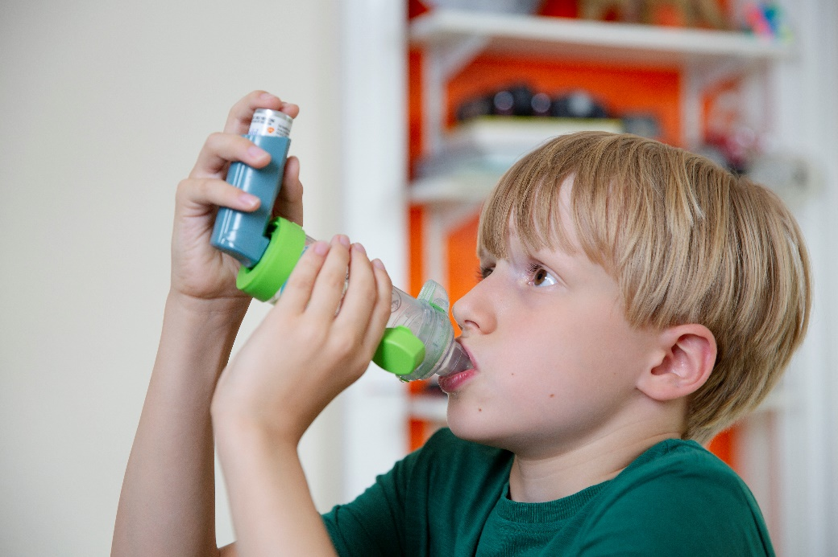
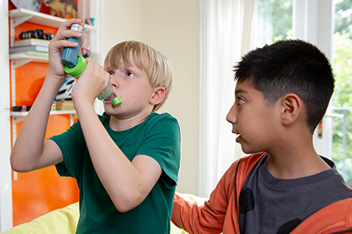
First aid skills Asthma attack – learn activity Put the numbers on the images in the order you think would be best to help someone who is having an asthma attack

Slide 4
First aid skills Asthma attack – learn activity Now see if you got the steps to help in the right order
How to help someone who is having an asthma attack
Someone having an asthma attack may find it hard to breathe. They may make a wheezing sound. Help them to sit down and rest in a comfortable position.
Tell them not to worry, and that you are going to help them.
Help them to use their inhaler.
Tell an adult. If there is no adult around call 999.

Slide 5
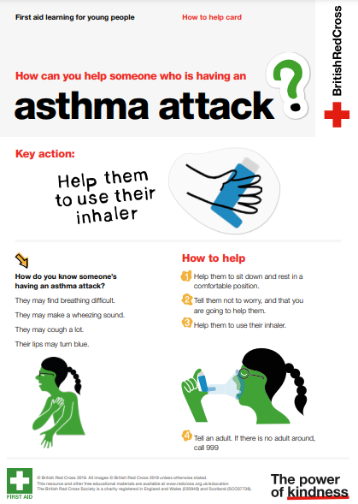
How to help someone who is having an asthma attack card Remind yourself of the steps to take to help someone who is having an asthma attack

