Slide 1
Introduction to the British Red Cross.
First aid champions
Notes:
Explain that you are going to discuss the work of the British Red Cross and learn a bit more about what they do in the UK and overseas

Slide 2
Introduction to the British Red Cross
Notes:
Ask the children if they have seen these symbols before. If they have, ask where they have seen the symbols.
You may wish to note their comments on the board.

Slide 3
Introduction to the British Red Cross
Notes:
Show this film about the work of the British Red Cross https://www.youtube.com/watch?v=q6v6aFwLFaQ (2.37 min).

Slide 4
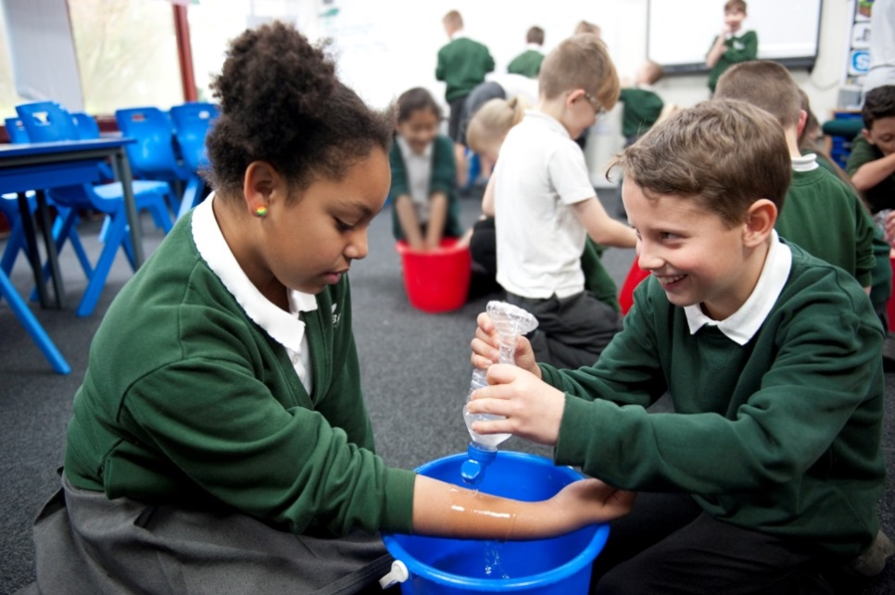
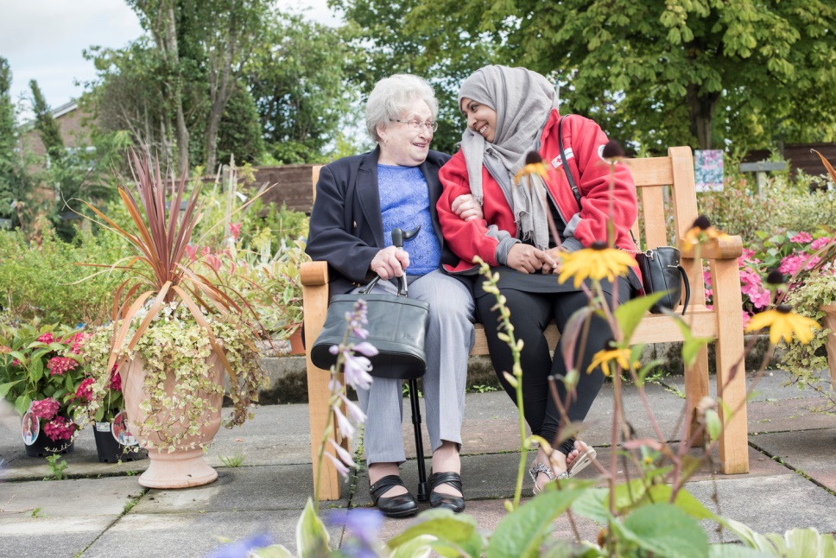
Introduction to the British Red Cross
- What is happening?
- Who is being helped?
- How might they be feeling?
Notes:
(from top left, anti-clockwise):
The British Red Cross
helps people to learn first aid and provides first aid support
supports people who need help at home or may be lonely
Photo credits (from top left, anti-clockwise)
Children learning first aid. Tracey Gibbs/ British Red Cross
British Red Cross Community Connector with service user. Percy Dean/British Red Cross

Slide 5
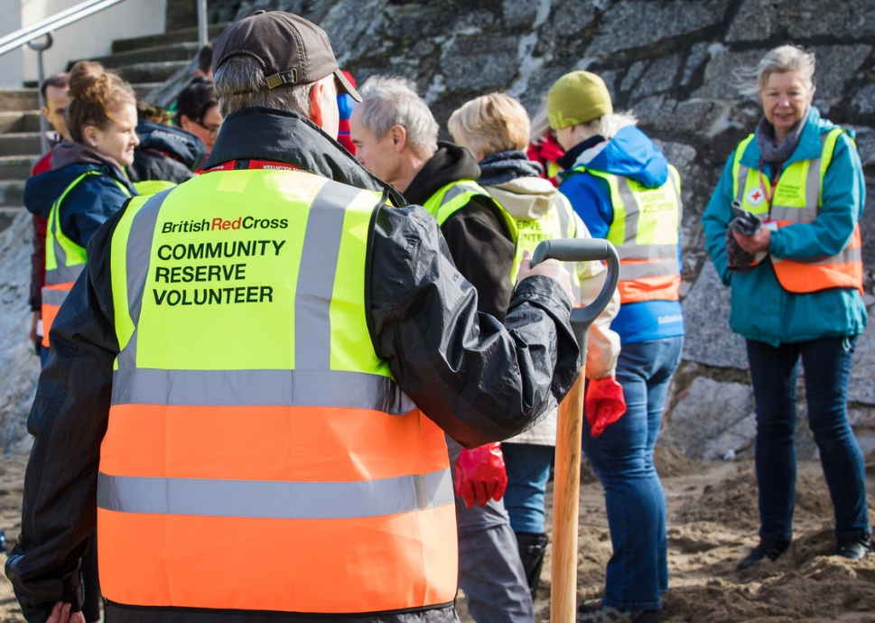
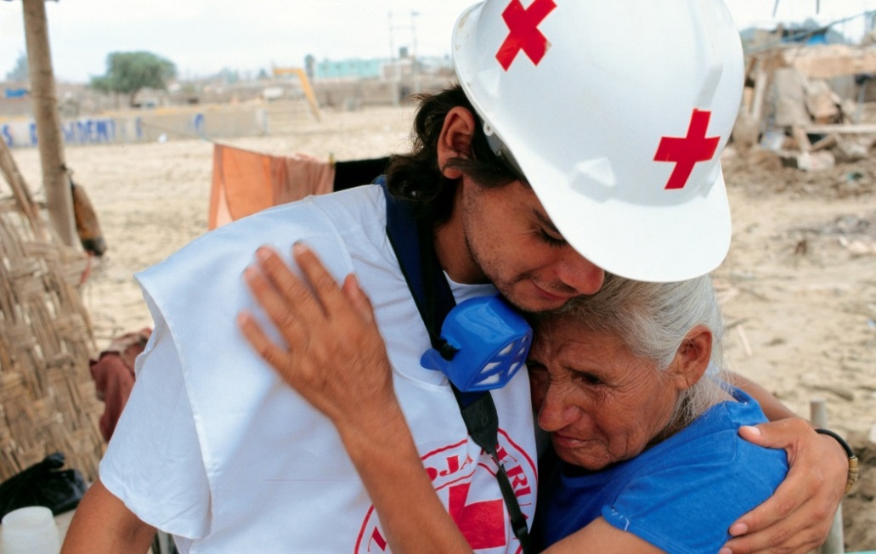
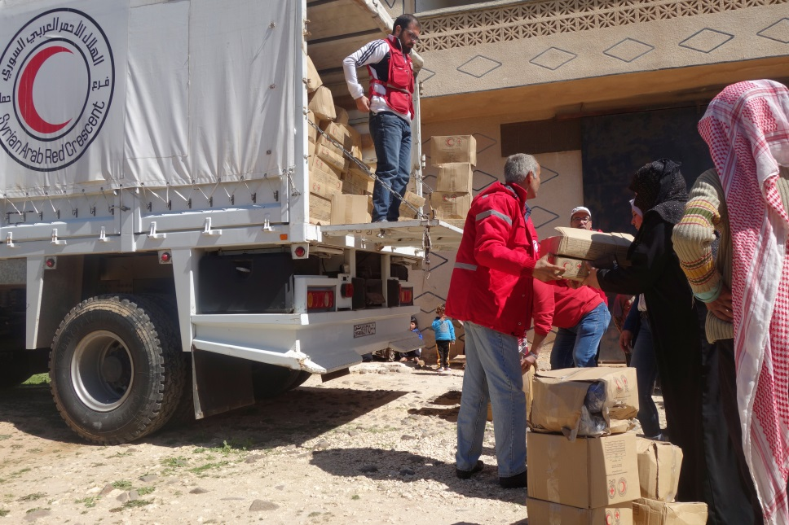
Introduction to the British Red Cross
- What is happening?
- Who is being helped?
- How might they be feeling?
Notes:
(from top left, anti-clockwise):
The British Red Cross:
Helps people in the UK when an emergency happens
Works with Red Cross and Red Crescent societies around the world to help people affected by disasters
Works with Red Cross and Red Crescent societies around the world to help people who are affected by war
Photo credits (from top left, anti-clockwise)
Community reserve volunteers (CRV) in Portreath, Cornwall in March 2017. Howard Laws/British Red Cross
Volunteer comforts a victim of a mud slide. Christopher Black / International Committee of the Red Cross (ICRC)
International Committee of the Red Cross (ICRC) distributing winter kits in Syria during war. Anas Kambal / International Committee of the Red Cross (ICRC)

Slide 6
How does the British Red Cross show the power of kindness?
Notes:
Kindness and the British Red Cross­
The British Red Cross believes that kindness is really powerful and that we should share our kindness with others. When we do share our kindness it can make a big difference. As a charity the Red Cross sees this kindness every day in the work that it does to help people in crisis in the UK and overseas.

Slide 7
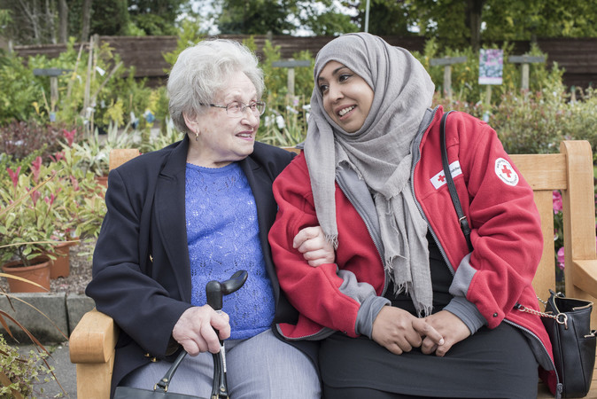
Introduction to the British Red Cross
- The Red Cross supports people who need help at home or may be lonely.
Photo credit: Percy Dean/British Red Cross
Notes:
British Red Cross Community Connector Nazia Rehman with service user Edith Steiner.

Slide 8
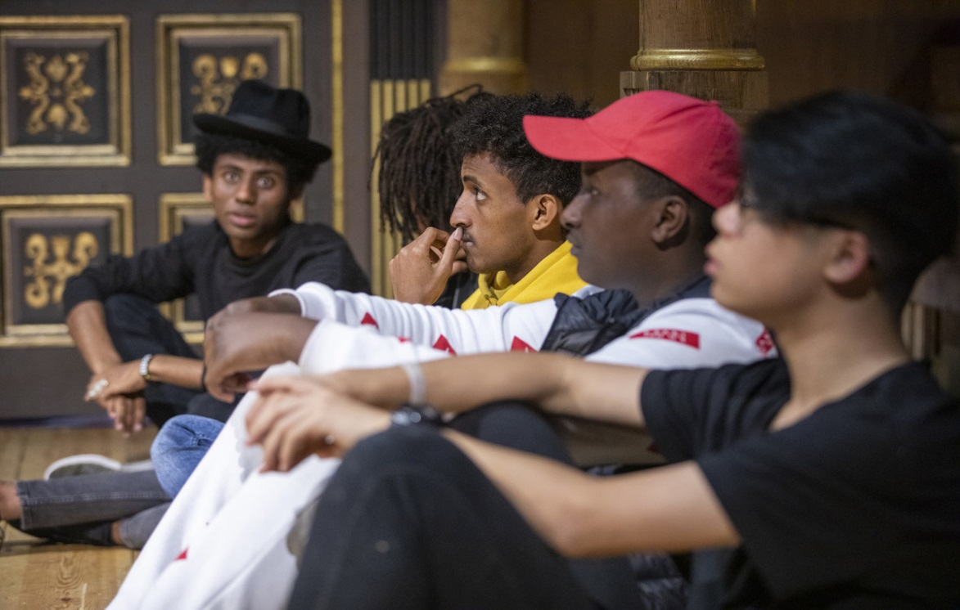
Introduction to the British Red Cross
- The Red Cross supports refugees and asylum seekers, these can be people who have had to leave their home because of troubles like war. We also help people to find their families if they have been separated.
Photo credit: Claudia Leisinger/British Red Cross
Notes:
Young Refugee Project by the Red Cross & Compass Collective at the Globe theatre Rehersal space.

Slide 9
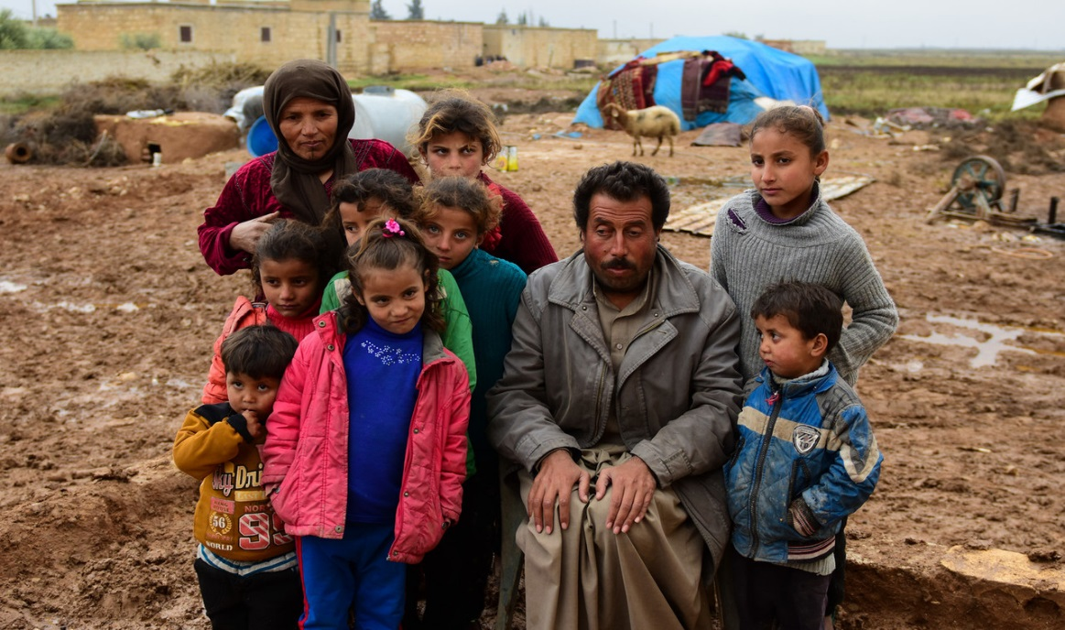
Introduction to the British Red Cross
-The British Red Cross works with other Red Cross and Red Crescent Societies around the world to help people who have fighting in their country. We support them with things like food, water and healthcare.
Photo credit: Alicia Melville-Smith / British Red Cross
Notes:
This photo was taken in Syria

Slide 10
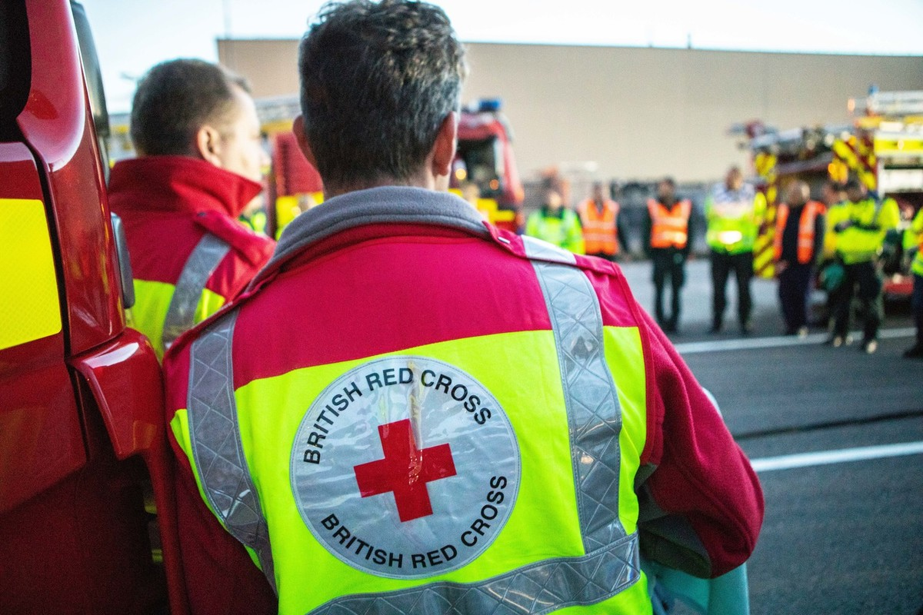
Introduction to the British Red Cross
- When there is an emergency, the Red Cross helps people with first aid, food and water, and if needed, somewhere to sleep.
Photo credit: Antonio Zazueta Olmos/British Red Cross
Notes:
British Red Cross emergency responders in high visibility vests, during an emergency response training at the Honda factory in Swindon.

Slide 11
Introduction to the British Red Cross
Write or draw what kindness means to you.
Notes:
Reflection
You could reflect on this presentation by asking your class to write or draw what kindness means to them, and consider how helping people with first aid shows kindness.

