Slide 1
Practise safety stories.

Slide 2
Story cards
a. You are playing football in the park with a friend. Your friend’s dad is on a bench. A man on another bench nearby has been eating his lunch. Suddenly he stands up and looks scared. He looks like he can’t breathe, and he is pointing at his neck.
b. You are in the school playground. A group of your friends are running about quickly. You see one of them trip over a coat that has been left on the ground. They hit their head very hard on the ground and say their head is hurting a lot.
c. You are running down the stairs with a group of your friends at school. One of your friends falls down the stairs in front of you, and is now crying loudly and holding their arm in a lot of pain.
d. You are in a café with a friend and their parents. A waiter goes past with a tray. The waiter trips and hot pot of tea falls from the tray onto the arm of a woman sitting on the table next to you. She is upset, and her arm goes very red.
e. You are at home and your mum has asked you and your little sister to sort out the recycling. You are both rushing because you want to play a new game when you have finished. Your sister cuts herself badly on a very sharp tin. It is bleeding a lot.

Slide 3
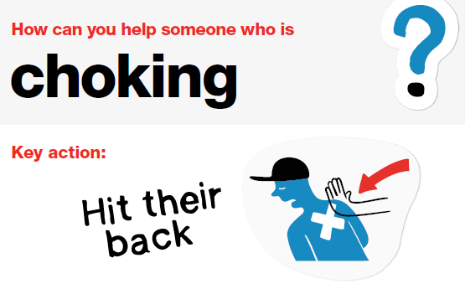
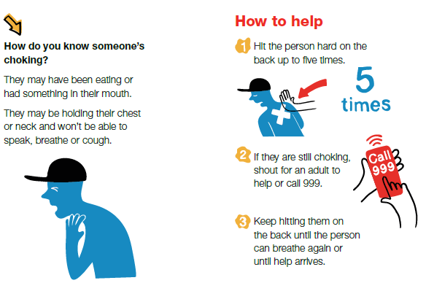
You are playing football in the park with a friend. Your friend’s dad is on a bench. A man on another bench nearby has been eating his lunch. Suddenly he stands up and looks scared. He looks like he can’t breathe, and he is pointing at his neck.

Slide 4
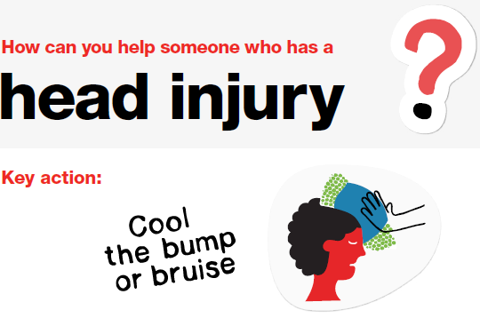
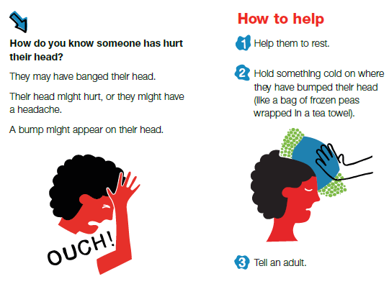
b. You are in the school playground. A group of your friends are running about quickly. You see one of them trip over a coat that has been left on the ground. They hit their head very hard on the ground and say their head is hurting a lot.

Slide 5
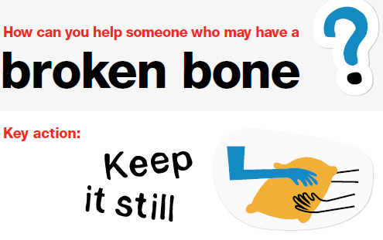
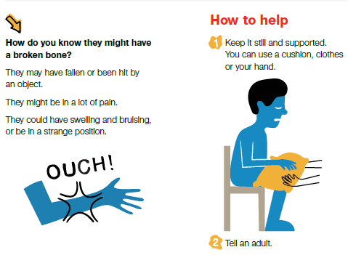
c. You are running down the stairs with a group of your friends at school. One of your friends falls down the stairs in front of you, and is now crying loudly and holding their arm in a lot of pain.

Slide 6
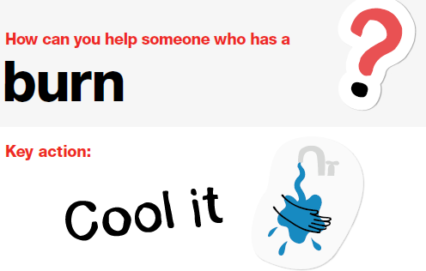
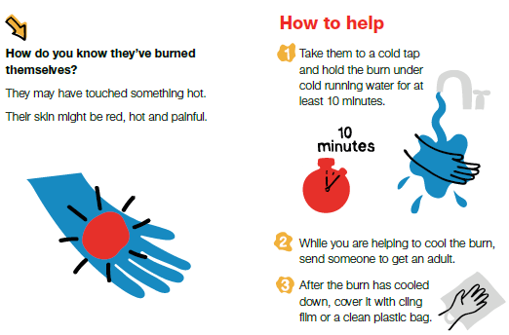
d. You are in a café with a friend and their parents. A waiter goes past with a tray. The waiter trips and hot pot of tea falls from the tray onto the arm of a woman sitting on the table next to you. She is upset, and her arm goes very red.

Slide 7
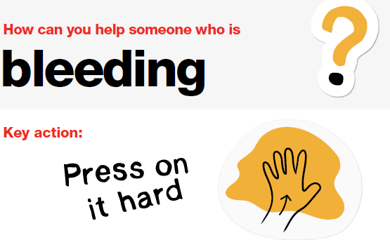
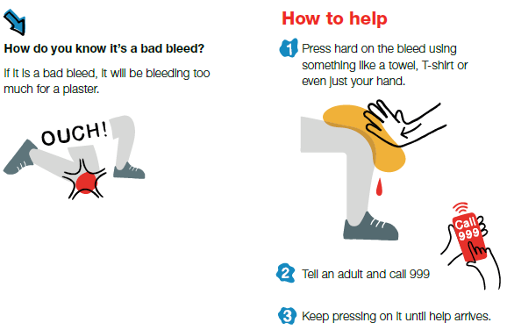
e. You are at home and your mum has asked you and your little sister to sort out the recycling. You are both rushing because you want to play a new game when you have finished. Your sister cuts herself badly on a very sharp tin. It is bleeding a lot.

Slide 8
Discussion questions
What was happening in this story?
Was anyone injured? What needed to be done to help them? What was the right first aid action to take?
What did the characters need to think about to keep themselves and others safe? What did they do to keep themselves and others safe? Was there anything else they needed to think about?

Slide 9
Summing up
In which stories did the characters need to think about safety the most?
What did the characters do to keep themselves safe?
What are the key things to remember when helping others and keeping yourself safe?

