Slide 1
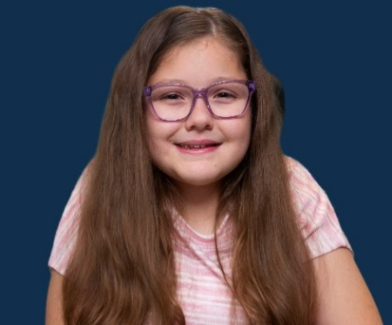
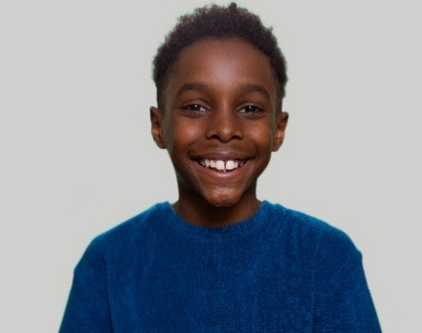
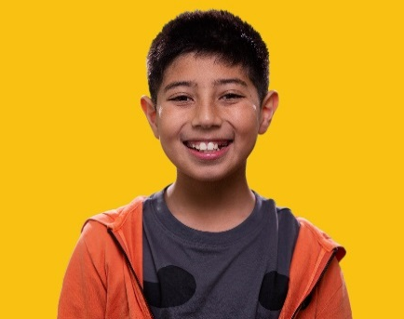
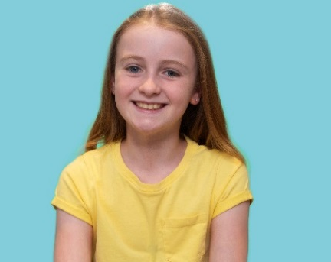
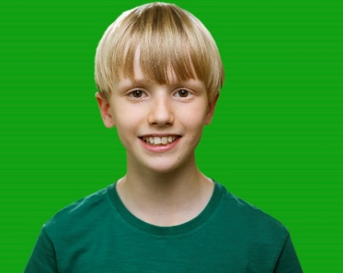
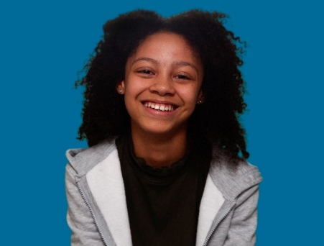
Meet the characters.
First aid champions.

Slide 2
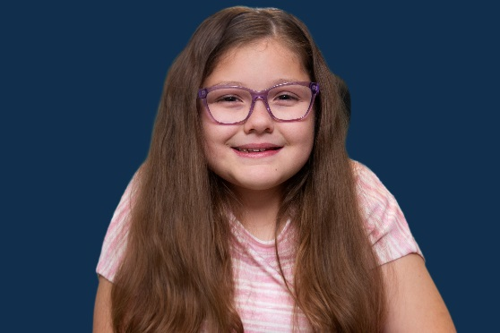
Meet the characters Beth
Beth
“Hey, I’m Beth! I really enjoy being creative and spend a lot of time drawing, listening to music and reading in my bedroom. I love spending time with my dog but have to be careful when I’m eating ice cream around her because she always wants to share it with me.”
Click on Beth’s photo to view her film

Slide 3
Meet the characters Dele
Dele
“Hi I’m Dele, I’m awesome at computer games and I’d like to be a pro gamer. I also love playing football and reading all sorts of books. I write a lot too and my favourite stories are set in the future, when I’ll probably be busy being a pro gamer!”
Click on Dele’s photo to view his film

Slide 4
Meet the characters Ekam
Ekam
“Hi I’m Ekam, I’m very musical. I play the piano and oboe. I get around on my hoverboard and take it to the park where there’s a zip line, I just wish it was longer. When I have time I like to read my comics and play outside with my two cats.”
Click on Ekam’s photo to view his film

Slide 5
Meet the characters Georgia
Georgia
“Hi. I’m Georgia. I have lots of confidence and I like to try everything once. At the moment, my favourite thing is skateboarding which I’m practising every day. I also get around on my scooter and I sing loads because I want to perform on stage. I just enjoy messing around and having fun.”
Click on Georgia’s photo to view her film

Slide 6
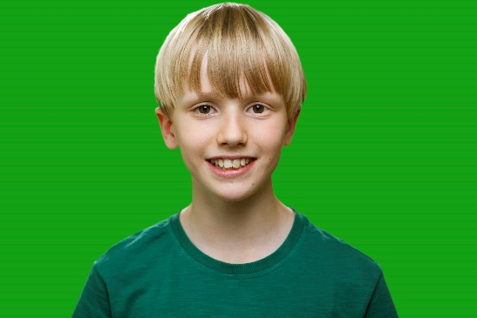
Meet the characters Jonjo
Jonjo
“Hi I’m Jonjo, I really enjoy being outside and I love taking my bike out with my Dad in the countryside. I’m really active and I sometimes find it hard to keep still. My favourite subjects are science and history because I want to learn more about animals and ancient stuff but mainly because I love dinosaurs!”
Click on Jonjo’s photo to view his film

Slide 7
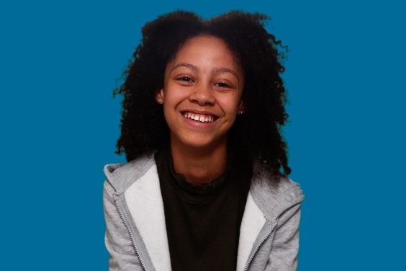
Meet the characters Liya
Liya “Hi I’m Liya, I love to cook and my favourite food is Mexican because it’s messy and tastes awesome! I’m a great swimmer and would like to train as a lifeguard so I can rescue people. When I’m not out and about at school, swimming or with my friends, I really enjoy watching films on a big screen with loads of popcorn, dancing like no-one’s watching and reading a good book.”
Click on Liya’s photo to view her film

Slide 8
Meet the characters Reflection
Now you have met the characters –
What are their likes and dislikes?
Do any of them like or do similar things to you?
Could you make your own mini-world film or story about yourself?

