Slide 1
Head injury.
First aid champions
Learn how to help someone who has a head injury

Slide 2
First aid skills Head injury – learn activity
Sequencing activity
Put the images on the next slide in order of how to help someone who has a head injury.
Can you show the correct order of what to do when someone needs first aid help?
You can look at the ‘how to help’ someone who has a head injury card to help you.

Slide 3
First aid skills Head injury – learn activity Put the numbers on the images in the order you think would be best to help someone who has a head injury

Slide 4
First aid skills Head injury – learn activity Now see if you got the steps to help in the right order
How to help someone who has a head injury
Help them to rest.
Hold something cold where they have bumped their head (like a bag of frozen peas wrapped in a tea towel).
Tell an adult. If they become sleepy, vomit or seem confused, call 999.

Slide 5
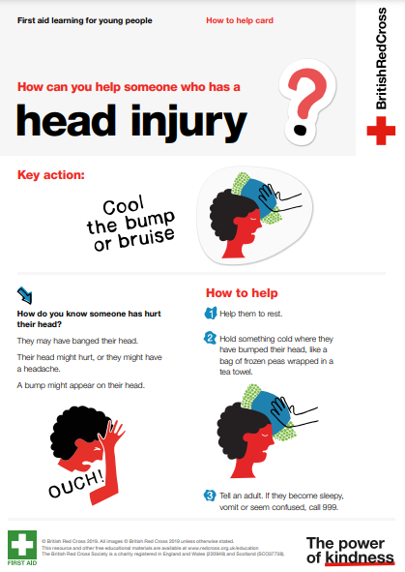
How to help someone who has a head injury card Remind yourself of the steps to take to help someone who has a head injury

