Slide 1
Keeping calm.
Kindness and coping Practise coping skills activity

Slide 2
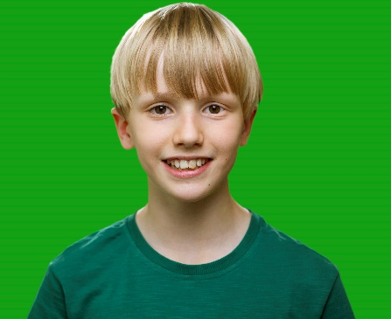
Kindness and coping
Practise coping skills
Keeping calm
“Hello, just me, Jonjo. When I feel upset, there’s a breathing exercise I use - called 'breathing with colour'. It helps me feel better, calmer and able to do what I need to do. What I do is, I imagine a calming colour like blue. As I breathe in, I imagine that colour and then as I breathe out, I imagine a bad or negative colour, like grey – I imagine breathing in with the good and out with the bad. It really makes me feel calm and prepared. Keep calm!”
Click on the photo of Jonjo to play the film from the coping skills page.

