Slide 1
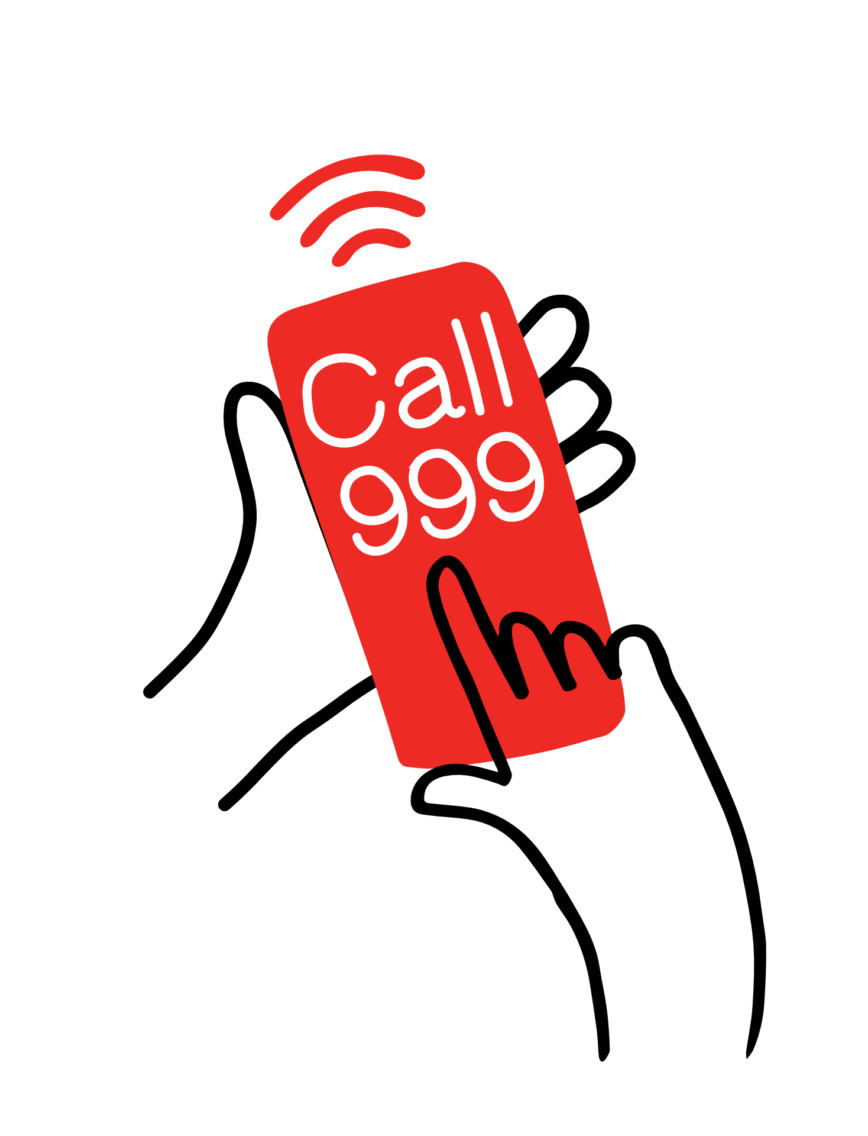
Calling 999.
Practise calling 999 Role-play cards

Slide 3
