Slide 1
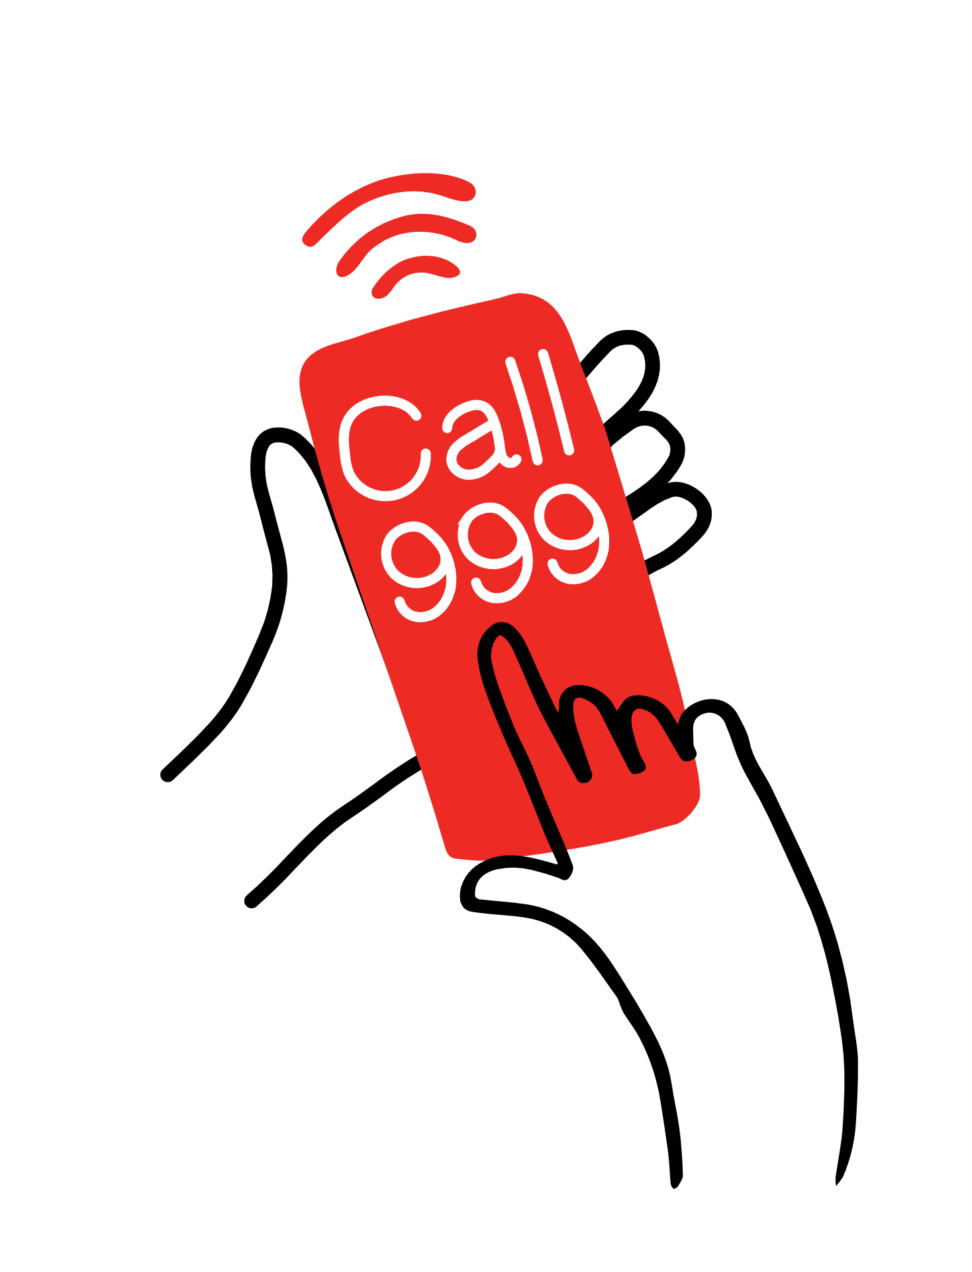
Calling 999.
Practise calling 999 Role-play cards

Slide 2
This person is called Ben. They live at 23 Flower Street. Their mum has cut her hand and is bleeding a lot. Ben has helped her to press hard on the cut already.
This person is Becky. Her brother is choking. His dad is helping him as she calls 999. They live in flat 4B, Basil Tower, 43 Picket Road.

Slide 3
This person is AJ. He is outside of his school alone – Bluebell Primary School - a man looks like he needs help. He looks like he can’t breathe very well. AJ doesn’t know what is wrong with him. He can’t talk and he is just sitting on the floor.
This person is Sarah. She is at the park with her grandparents, it is called Victoria Park, it is next to the big supermarket. A man fell to the floor and now he seems be asleep (he is unresponsive and breathing), he won’t answer or move.
This person is Marcus. Marcus’ friend Peter hit his head earlier today when they were playing football. He banged heads with another boy. He was fine, but now he seems dizzy and keeps being sick. They are walking home from the park. They are on Morton Avenue, near the corner shop.

Slide 4
Remember to: Ask the questions clearly and calmly Be kind to the caller Start by saying: Operator Hello, emergency service operator. Which service do you require? Fire, police or ambulance? Operator I’ll connect you now… Call handler: Ambulance service, where is the help needed? Key questions to ask What is your address/ where are you? What happened/ what is the problem?

Slide 5
Extra questions you could ask
Is anyone else there helping the person?
How old is the ill or injured person?
Is the person responding to you? Does the person wake up or respond when you gently shake their shoulders?
Is the person breathing? Can you see their chest rising and falling? Can you feel their breath on your cheek?
Is the person bleeding? If so, how badly?
Are there any dangers around?
Things to tell them
I’m going to ask you some more questions, please try and answer them as well as you can.
Okay, an ambulance is on its way to you.
Stay on the phone with me, you are doing really well.

