Slide 1
Bleeding.
First Aid Champions
How to help someone who is bleeding

Slide 2
First aid skills Bleeding – learn activity
Sequencing activity
Put the images on the next slide in order of how to help someone who is bleeding.
Can you show the correct order of what to do when someone needs first aid help?
You can look at the ‘how to help’ someone who is bleeding card to help you.

Slide 3
First aid skills Bleeding – learn activity Put the numbers on the images in the order you think would be best to help someone who is bleeding

Slide 4
First aid skills Bleeding – learn activity Now see if you got the steps to help in the right order
How to help someone who is bleeding
Press hard on the bleed using something like a towel, T-shirt or even just your hand.
Tell an adult and call 999.
Keep pressing on it until help arrives.

Slide 5
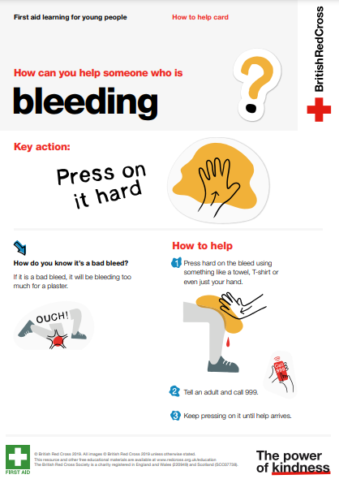
How to help someone who is bleeding card Remind yourself of the steps to take to help someone who is bleeding

