Slide 1
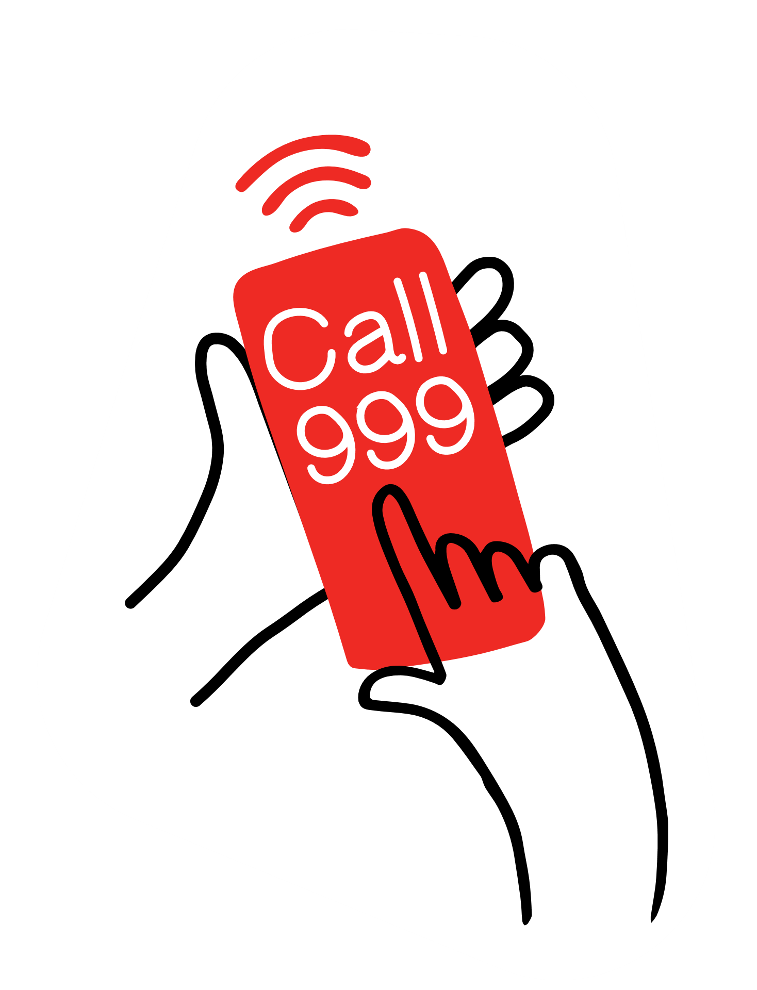
Calling 999.
Safety: learn
Calling 999

Slide 2
Safety: learn Calling 999
Lilly-Mae’s 999 call
Call-handler: Ok, is she breathing?
Girl: I don’t know because I can’t wake her up
Call-handler: Right, tell me exactly what’s happened
Girl: She’s falled on the floor and she spinned her head round
Call-handler: How far did she fall?
Girl: Really far cos she’s really big
Call-handler: What’s your name?
Girl: Lily-Mae
Call-handler: OK, how old are you?
Girl: Six
Call-handler: Just go to your front door where you’d let the people in and go let the ambulance people in. Hello, is the ambulance people there?
Girl: Yep.
Call-handler: They’re there with you? OK, go and show them where your mummy is
Paramedic: Portia? Portia, can you hear me?
Call-handler: Are there people there with you now? Are the people from the ambulance there with you?
Girl: Yes
This transcript is part of a real 999 call that can be listened to here: https://www.bbc.co.uk/news/av/uk-england-derbyshire-38321371/girl-six-calls-999-after-mum-collapses
Notes:
Answer: 999

Slide 3
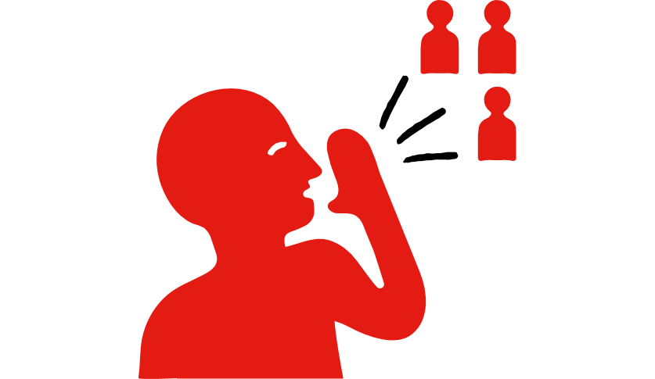
Safety: learn Calling 999
What is the number you need to call in an emergency?
a) 999
b) 111
c) 101
Notes:
Answer: 999

Slide 4
Safety: learn Calling 999
What questions will the 999-call handler ask you?
a) What the time is it and what colour is your hair?
b) Where was your last holiday and was it fun?
c) What’s happened and what’s your address?

Slide 5
Safety: learn Calling 999
What might help you to stay calm when calling 999?
a) yelling loudly
b) breathing deeply
c) running around

Slide 6
Safety: learn Calling 999
Answers
What is the number you need to call in an emergency?
999
111
101
What questions will the 999-call handler ask you?
a) What time is it and what colour is your hair
b) Where was your last holiday and was it fun
c) What’s happened and what’s your address
What might help you to stay calm when calling 999?
a) yelling loudly
b) breathing deeply
c) running around

Slide 7
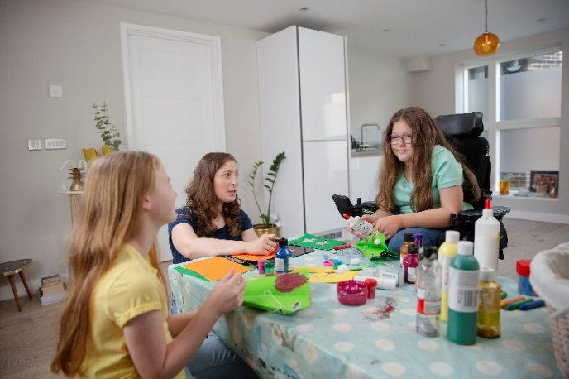
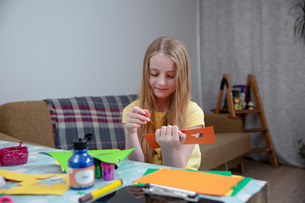
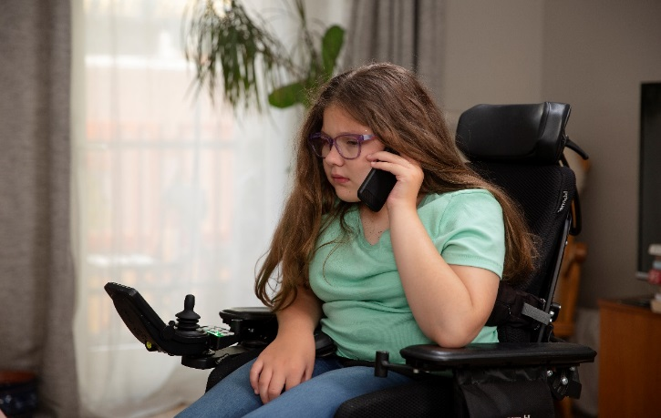
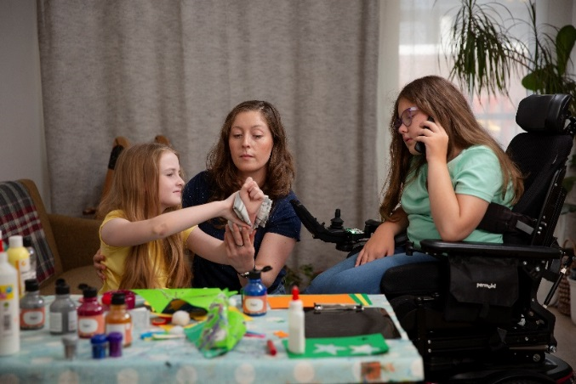
What is happening in these photos?
What does Beth do to help her friend who is bleeding?
Notes:
Use the cards to role-play this scenario

Slide 8
What was happening in the photos?
Beth and her friend make masks at the table
Beth’s friend Georgia is using a craft knife, by the way she is holding the card she may cut herself
Georgia has accidently cut herself with the craft knife and is bleeding, she presses on the bleed hard with a cloth
it is a bad bleed so Beth calls 999 to get help
Beth’s mum reassures Georgia and reminds her to press hard on the bleed until help arrives. Beth stays on the phone with the 999 call-handler until help arrives.

Slide 9
A reminder of how to help someone who is bleeding

Slide 10
Calling 999.
If you know someone is ill or injured and needs help from a doctor quickly:
Call 999 and ask for an ambulance
Listen to the call handler and answer their questions as best as you can

